Slide 1
Ready4Tech TypeSpec and the Contract-first approach
Sebastien Mornas & David Rozen – ISD Consultants
January 2024
APP0092

Slide 2
Agenda
Contract-first development
Code-first vs Contract-first API development
What problems does it solve?
An overview of TypeSpec
What is TypeSpec?
The TypeSpec syntax
The TypeSpec emitters
TypeSpec demo
What’s next?

Slide 3
Contract-first development

Slide 4
Code-first vs Contract-first API development
Specify API signature
Implement API in code
Test API code
Deploy API in API Management
Generate OpenAPI spec
Deploy code
Generate client code

Slide 5
Code-first vs Contract-first API development
Specify API with TypeSpec
Generate server code
(optional)
Implement API in code
Deploy API in API Management
(without a backend at first!)
Test API code
Generate client code
Deploy code

Slide 6
What problems does it solve?
Fast prototyping API signatures without writing actual code
Finer-grain Open API spec, avoiding duplication of anonymous models and bad naming from tools like Swashbuckle
Generating low-value code (models, error management, controller scaffolding, etc.)
Easier cross-teams collaboration, especially when one team is responsible with the server code and the other with client code
Some frameworks are intrinsically contract-first:
The principle is then to attach handler code to operations that are primarily defined in the Open API spec and not the other way around

Slide 7
An overview of TypeSpec

Slide 8
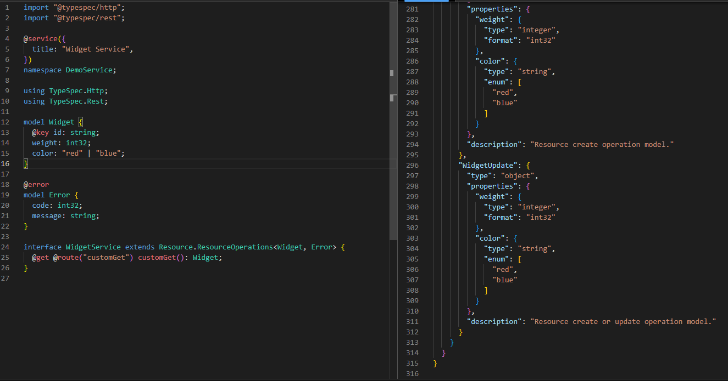
What is TypeSpec?
A new declarative language from Microsoft
Allows multi-protocol code / doc generation
Main goals of TypeSpec:
Reusability: reuse structure and ensure consistency across different APIs, avoiding repetitions
Modularity: small modules, keep things related to the same APIs together
Expressiveness: generates a lot of code with simple base code
Multi-protocol: generates Open API (Swagger), gRPC (Protobuf), JSON Schema with same paradigm
Extensibility: can be extended using custom code

Slide 9
The TypeSpec syntax (1/4)
TypeSpec inherits some of its syntax from TypeScript
Operations are defined inside interfaces
import "@typespec/http";
interface Widgets {
...
}
To import internal or external modules
namespace DemoService;
Segregate parts of the contract in sub-domains
color: "red" | "blue";
id: string;
We can define union types
Same kind of primitive types (not really, but more on that later)
enum Country {
France,
Spain,
Germany,
Italy,
}
We can use enum to enumerate multiple options

Slide 10
The TypeSpec syntax (2/4)
model Person {
id: uuid;
firstName: string;
lastName: string;
@minValue(0)
@maxValue(99)
age?: int32;
address?: {
street?: string;
@pattern("^[0-9]{5}$")
zipCode: string;
city: string;
country: Country;
};
}
We use models to define complex objects
Alias avoid repeating inline code (like a constant string for instance)
alias Uuid4Pattern = "^[0-9a-fA-F]{8}-[0-9a-fA-F]{4}-4[0-9a-fA-F]{3}-[890abAB]{1}[0-9a-fA-F]{3}-[0-9a-fA-F]{12}$";
We can extend primitive types with the scalar keyword:
@format("uuid4-v1")
@pattern(Uuid4Pattern)
scalar uuid extends string;
The ? define properties as non-required; properties are required by default!

Slide 11
The TypeSpec syntax (3/4)
@route("/users")
interface UserService {
@get
getUser(
@path userId: uuid,
): UserApiResponse | NotFoundResponse | ErrorResponse;
@post
createUser(@body user: User): {
@statusCode
statusCode: 201;
} & User | ErrorResponse;
@put
updateUser(
@path userId: uuid,
@body user: User,
): UserApiResponse | ErrorResponse;
@delete
deleteUser(
@path userId: uuid,
@query hard?: boolean = false
):
NoContentResponse | ErrorResponse;
}
Defining operations
For simple operations we can use “op”:
@get
@operationId("health")
@route("/healthcheck")
op healthcheck():
HealthCheckApiResponse |
ErrorResponse;
To group operations in logical blocks, we can use “interfaces” instead
The union of all response types is described with a union type

Slide 12
The TypeSpec syntax (4/4)
Decorators are used to describe how models and operations will be emitted:
Validation rules (min, max, patterns, formats, etc.)
Documentation
HTTP verbs and routing attributes (OpenAPI emitter only)
Fields attributes (Protobuf emitter only)
@route("/users")
@deprecated("Use the new API instead")
interface UserService {
@get
@operationId("getAllUsersV1")
@doc("Get all users from the database.")
@summary("Get all users")
@tag("PrivateApi")
getUsers(): {
@statusCode
statusCode: 200;
@body
body: User[];
@header("X-Total-Count")
@doc("The total number of users")
totalCount: int32;
};
}

Slide 13
The TypeSpec emitters (1/2)
TypeSpec comes with three emitters built-in:
OpenAPI 3.0: generates OpenAPI specs (AKA swagger files)
Protobuf: generates proto files to be used for gRPC services
JSON schema: generates JSON schema for validating JSON objects
The Azure Product Group has created an additional emitter:
Swagger 2.0: similar to the OpenAPI 3.0 emitter but for the older Swagger spec
You can build your own!
TypeSpec comes with a framework to build custom emitters
tsp compile . --emit=@typespec/openapi3
To specify the emitter for the generation

Slide 14
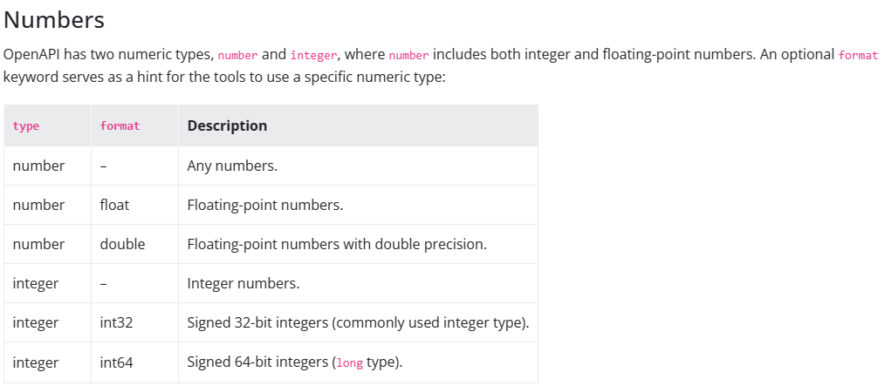
The TypeSpec emitters (2/2)
TypeSpec scalars differ from TypeScript primitive types because they represents types of the emitter
For example, OpenAPI has both number types and formats:
Open API:
NumberExample:
type: object
required:
- foo
- bar
properties:
foo:
type: integer
format: uint8
bar:
type: number
format: double
TypeSpec:
model NumberExample {
foo: uint8;
bar: float64;
}

Slide 15
Demo

Slide 16

What’s next?
Play with TypeSpec Playground
https://microsoft.github.io/typespec/playground
Install TypeSpec VS Code extension
https://microsoft.github.io/typespec/introduction/editor/vscode
Swagger Server Mock generator
https://editor-next.swagger.io
Kiota API Client Generator
https://learn.microsoft.com/en-us/openapi/kiota/
See our sample code repository:
https://github.com/tindav/R4TechAPP0092-TypeSpec
Rate this session!❤️
Session code : APP0092

Slide 17
Thank You
Notes:
Thank you.

